Slide 1

Repeat Buyer Prediction for E-Commerce
方有正 杨云轩 林天浩

Slide 2





1
Introduction
CONTENTS
2
Feature Engineering
3
Model Applications
4
Experimental Results
5
Conclusion

Slide 3






01
Introduction

Slide 4




Background
01
The Rapid Development of E-commerce
With advancements in internet technology, the scale of the e-commerce market continues to expand, and competition becomes increasingly fierce.
02
Changes in Consumer Behavior
Consumers’ purchasing habits and preferences are becoming more diverse, and their demands for a better shopping experience are constantly increasing.
03
The Importance of Repeat Purchases
Repeat purchases are key for e-commerce companies to maintain profitability and growth, playing a critical role in their long-term development.

Slide 5
02
Feature Engineering

Slide 6

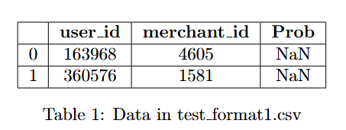
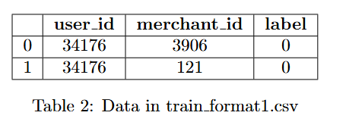
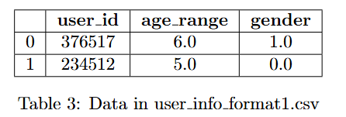
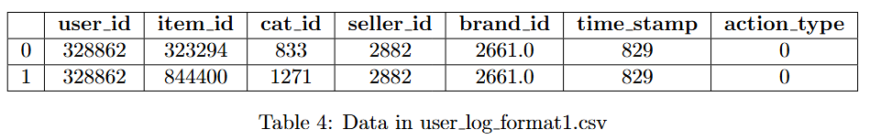
Data Overview
01
Testing and Training Data
02
User Information
03
User Log

Slide 7




Two Entities and One Interaction
User
User-merchant interaction
Merchant

Slide 8













Basic Features
Count/Ratio Features
Attributes like counts of actions, the number of days users are active,
the proportion of a particular action type over all action type...
Age/Gender Related Features
Features such as age range and gender, one-hot encoded
Repurchase Features
The tendency of users and merchants to engage inrepeat transactions, calculated as the fraction of merchants with which the user made multiple pur-chases

Slide 9
03
Model Applications

Slide 10







Logistic Regression
01
Principles
Finds the optimal hyperplane to maximize separation between different classes in space.
02
Characteristics
Excels with small samples and high-dimensional data, offering good generalization ability.
03
Application Domains
Suitable for cases with clear linear relationships, such as credit scoring.

Slide 11
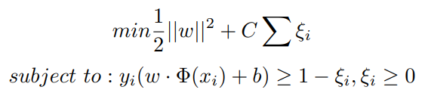
Support Vector Machine (SVM)
01
Priciples
Finds the optimal hyperplane to maximize separation between different classes in space.
02
Characteristics
Excels with small samples and high-dimensional data, offering good generalization ability.
03
Limitations
High computational complexity and relatively poor performance on large datasets.

Slide 12
Random Forest
01
Core Idea
Handles high-dimensional data, resists overfitting, and is robust to noisy data.
02
Advantages
Comprises multiple decision trees, leveraging ensemble learning to improve prediction accuracy.
03
Limitations
Limited model interpretability and potentially long training times.

Slide 13
XGBoost
01
Core Idea
Based on gradient boosting, with regularization to prevent overfitting.
02
Characteristics
Offers high prediction accuracy, fast computation, and good scalability.
03
Application Domains
Widely used in data competitions, financial risk control, and other fields.

Slide 14
04
Experimental Results

Slide 15
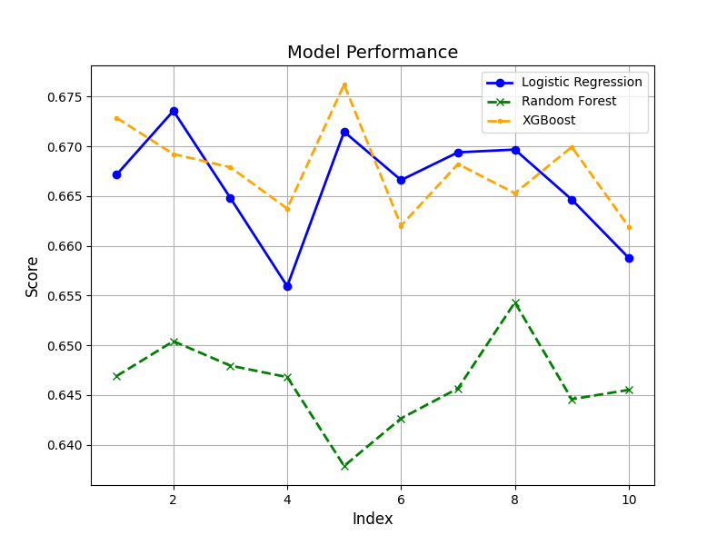
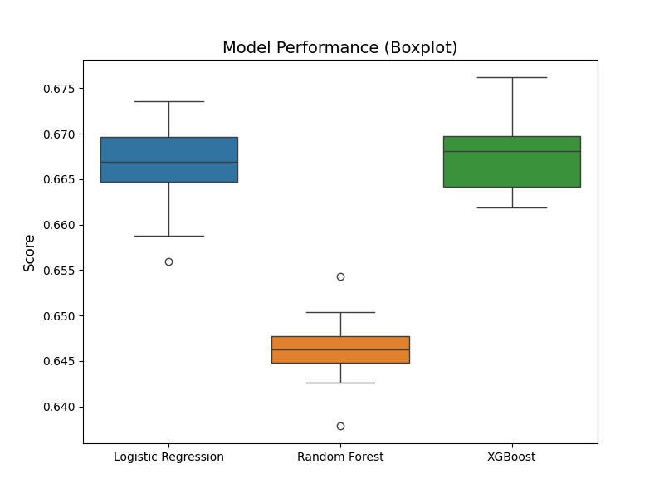



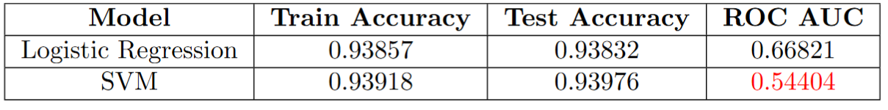
Performance Evaluation of Different Models

Slide 16
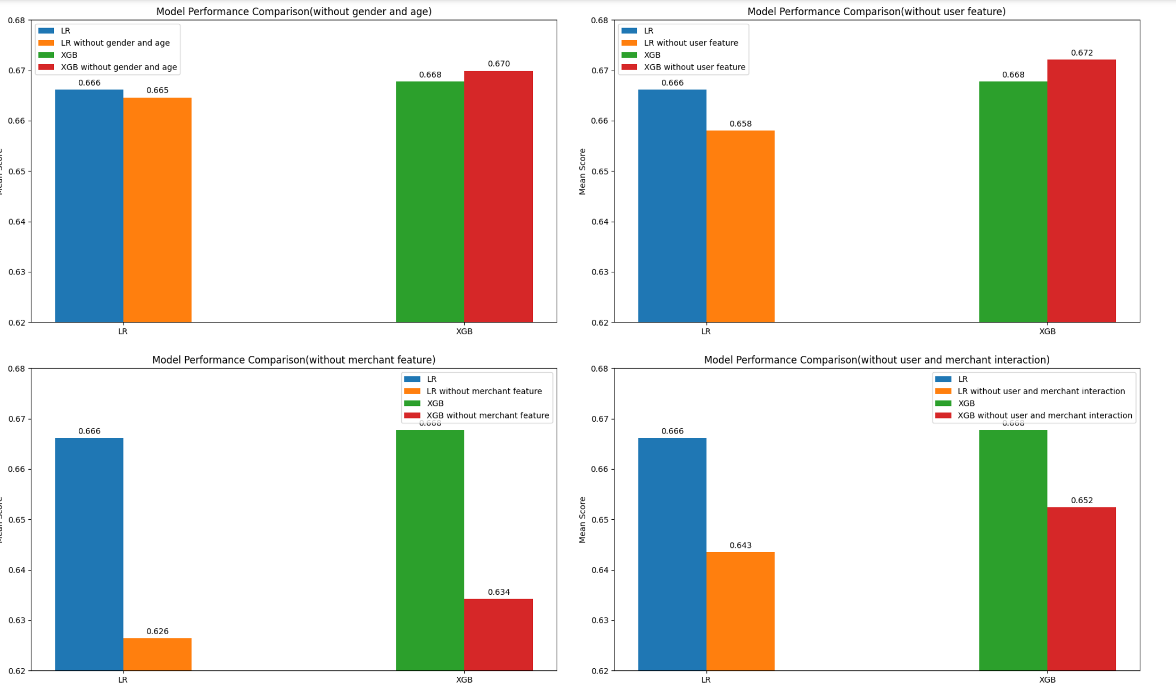
Feature Correlation Analysis

Slide 17
05
Conclusion

Slide 18









研究总结
Key Findings
Identified important factors influencing repeat purchases.
Discovered patterns and trends in user purchasing behavior.
Determined repeat purchase tendencies across different user groups.
Results Evaluation
Achieved high accuracy and recall rates.
Provided practical guidance for e-commerce platform operations.
Offered strong evidence for developing relevant strategies.
Data and Methods
Collected and analyzed extensive user purchase data.
Applied various statistical and machine learning algorithms for data processing.
Built accurate and effective predictive models.

Slide 19










Future Work
01
02
03
Technological Advancements Explore advanced algorithms and models, integrate multi-source data, and enhance adaptability to a changing market environment.
Application Expansion
Apply predictions to personalized marketing, assist in customized recommendations, and improve efficiency in supply chain management.
Ongoing Research
Track user behavior changes, update models in a timely manner, and stay aligned with industry innovations.

Slide 20
THANKS FOR LISTENING
演讲人：比小格

